Slide 1
Emergency Preparedness
TA/AI Session
April 20th, 2017

Slide 2
Table of Contents
Distress & Disruptive Behavior
Title IX
BE SAFE Campaign
Campus Violence & Campus Carry

Slide 3
As a student and responsible employee, when you meet emergency situation, you have to take actions.
The Emergency Preparedness Training is going to help you deal with similar cases.

Slide 4

You’re the senior person representing the university when you have students with distress or/and disruptive behaviors, or involved in sexual problems. You are required to know what to do in the emergency situations.
From this session, you will be able to know what resources are there for you and what we encourage you to use. A lot of people and organizations are provided to support you.
Notes:
Image: https://pixabay.com/en/hand-united-hands-united-together-1917895/

Slide 5
2. Distress & Disruptive Behaviors

Slide 6
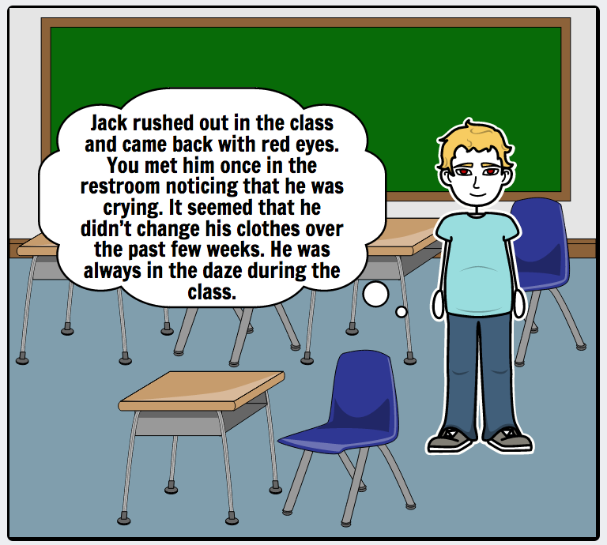
Have you ever met this situation before?
Have no idea of how to handle it？ ☹

Slide 7

If you are a new TA/AI, at first you may be inexperienced in dealing with these situations or feel unsure what to do, but you really want to help. You can call the behavior concerns advice line.

Slide 8
Why should you pay attention to students in distress or/and disruptive behaviors?
These students are high-risk population.
Mental illness is higher in students of college age.
Maybe it’s the first time for students to be away from family.
Financial issues become their own.
The stress and pressure comes from exams, wanting to do well.
Being in UT Austin community, which is very large and quite different from their former schools.
This is not especially at UT, but universal in colleges and universities.
Notes:
20:12

Slide 9

Sign of Distress - Decline in Academic Performance
Falling behind in schoolwork
Excessive absences or lateness
Repeated requests for special consideration, especially when this is a change from previous behavior
Avoiding participation, or becoming extremely anxious when called upon
Notes:
File Image (iStock)
http://www.istockphoto.com/photo/reduction-of-learn-gm477356570-66277939
Academic decline:
- falling behind in schoolwork.
- excessive absences or lateness.
- repeated requests for special consideration, esp when this is a change fr previous beh.
- disruptive beh in class.
- avoiding participation, or becoming extremely anx when called upon.
May become more socially isolated, less spontaneous.
Unusual appearance:
- deterioration in personal hygiene or dress.
- dramatic wt loss or gain.
- observable signs of injury.
May have difficulty managing their thoughts or feelings. Pay attention to emotional responses that are obviously inappropriate to the situation (eg, becoming extremely anx, angry, or distraught).

Slide 10

Sign of Distress - Unusual Appearance
Deterioration in personal hygiene or dress
Dramatic weight loss or gain
Observable signs of injury
Notes:
https://www.pexels.com/photo/bare-feet-boy-child-couch-262103/
Academic decline:
- falling behind in schoolwork.
- excessive absences or lateness.
- repeated requests for special consideration, esp when this is a change fr previous beh.
- disruptive beh in class.
- avoiding participation, or becoming extremely anx when called upon.
May become more socially isolated, less spontaneous.
Unusual appearance:
- May have difficulty managing their thoughts or feelings. Pay attention to emotional responses that are obviously inappropriate to the situation (eg, becoming extremely anx, angry, or distraught).

Slide 11

Sign of Distress - Decline in Social involvement
More socially isolated
Less spontaneous
Notes:
Decline in social involvement: May become more socially isolated, less spontaneous.
May have difficulty managing their thoughts or feelingsL Pay attention to emotional responses that are obviously inappropriate to the situation (eg, becoming extremely anx, angry, or distraught).
File image(istock)
Left one: http://www.istockphoto.com/photo/group-of-volunteers-at-clothing-drive-in-park-gm514226028-87981089
Right one: http://www.istockphoto.com/photo/3d-businessman-meditating-isolated-with-clipping-path-gm184966969-19080366

Slide 12

Sign of Distress - Difficulty of managing thoughts/feelings
Become extremely anxious, angry, or distraught
Hard to control temper
Notes:
Decline in social involvement: May become more socially isolated, less spontaneous.
May have difficulty managing their thoughts or feelings L Pay attention to emotional responses that are obviously inappropriate to the situation (eg, becoming extremely anx, angry, or distraught).
File image(istock)
Left one: http://www.istockphoto.com/photo/group-of-volunteers-at-clothing-drive-in-park-gm514226028-87981089
Right one: http://www.istockphoto.com/photo/3d-businessman-meditating-isolated-with-clipping-path-gm184966969-19080366

Slide 13



Examples of disruptive behavior in the classroom include, but are not limited to:
Make loud and distracting noises.
Monopolize classroom discussions.
Talk when the instructor or others are speaking.
Exhibit erratic, irrational behavior.
Behavior that distracts the class.
Refuse to comply with faculty direction.
Make physical or verbal threats to the faculty member or fellow classmates.
Notes:
1st one: https://www.shutterstock.com/ko/image-photo/young-funny-man-covering-earsdisagree-expression-534964603?src=nmrHAcpdz09rsFUIvQdOgQ-1-24
2st one: https://www.shutterstock.com/ko/image-photo/woman-interrupting-speaker-flip-chart-giving-322056773?src=5oYvFlWeKfrTZQHVLUFiTQ-1-2
3rd one: https://www.shutterstock.com/ko/image-vector/verbal-bullying-122152585?src=FYTzWjBNpb-MmEeugb71Wg-1-5

Slide 14
When is outside involvement a responsibility, not a choice?
When somebody
indicates suicidal thoughts
loses contact with reality
in disruptive or threatening behavior
Call 911 when that happens. You are not sure what to do, call 911.
Notes:
File image (iStock)
: http://www.istockphoto.com/photo/girl-with-suicidal-thoughts-gm508897932-85493465
Any reference to committing suicide should be taken seriously.
- No judgment about the seriousness or possible lethality of a suicidal thought or gesture should be made without consulting a mental health professional.
Behavior that poses a threat to others or seriously disrupts the classroom must be immediately addressed.
- verbal and non-verbal threats
- intimidating behavior
- violent acts (to people or property)
- other types of antisocial behavior (e.g., repeated lying, stealing, reckless disregard for safety of self or others)
Intervention varies with the severity of the offending behavior.
- minimally -- outlining the unacceptable behavior, requesting that the behavior stop, outlining the consequences of the behavior if do not stop, and referring student to appropriate campus resource.
- Physical violence causing bodily harm and specific threats must be reported to UTPD.

Slide 15
How can we do intervention?
Intervention varies with the severity of the offending behavior. However, KEEP IN MIND that physical violence causing bodily harm and specific threats must be reported to UTPD.
Otherwise, you need to do at least:
Outline the unacceptable behavior
Request that the behavior stop
Outline the consequences of the behavior if do not stop
Refer student to appropriate campus resource

Slide 16

How to approach student in distress & disruptive behavior
STEP 1
STEP 2
STEP 3
STEP 4
Give the student your undivided attention.
Let them talk with minimum interruptions.
Ask the students what they need from you.
Be as calm and straightforward as possible.
LISTEN
Notes:
File image(iStock)
http://www.istockphoto.com/photo/listening-gm467456289-26133878
Help relieve the distress by providing an opportunity for the student to talk abt their feelings.
LISTEN: give the student your undivided attention & let them talk with minimum interruptions. Ask the stud what they need fr you, & be as calm & straightforward as possible.
2) ACKNOWLEDGE the stud’s thoughts and feelings. Respect the stud’s value system, even if you don’t agree w/it.
Initiate problem-solving. You don’t need to know the answers or exactly what to do. Sometimes trying to solve a problem prematurely is counterproductive. However, you can give them an opportunity to think thru & talk about what’s troubling them.
3) Express concern: Let the students know that you’re concerned. Be specific about the behavior that gives you cause for concern (eg, “I’ve noticed you’ve been looking tired and stressed. Are you going through a rough time?”)
Help the student identify options & explore possible consequences.
4) Offer hope: Can also provide enough hope to enable a student to consult a professional or other appropriate person. This may include seeking help (CMHC), involving their family, talking to friends, etc.

Slide 17

How to approach student in distress & disruptive behavior
STEP 1
STEP 2
STEP 3
STEP 4
Respect the student’s value system even if you don’t agree with it.
Initiate problem-solving. Don’t need to know the answers or exactly what to do.
Sometimes trying to solve a problem prematurely is counterproductive.
Be able to give them an opportunity to think thru & talk about what’s troubling them
ACKNOWLEDGE
Notes:
https://pixabay.com/en/young-girl-smile-woman-facial-110174/
Help relieve the distress by providing an opportunity for the student to talk abt their feelings.
LISTEN: give the student your undivided attention & let them talk with minimum interruptions. Ask the stud what they need fr you, & be as calm & straightforward as possible.
2) ACKNOWLEDGE the stud’s thoughts and feelings. Respect the stud’s value system, even if you don’t agree w/it.
Initiate problem-solving. You don’t need to know the answers or exactly what to do. Sometimes trying to solve a problem prematurely is counterproductive. However, you can give them an opportunity to think thru & talk about what’s troubling them.
3) Express concern: Let the students know that you’re concerned. Be specific about the behavior that gives you cause for concern (eg, “I’ve noticed you’ve been looking tired and stressed. Are you going through a rough time?”)
Help the student identify options & explore possible consequences.
4) Offer hope: Can also provide enough hope to enable a student to consult a professional or other appropriate person. This may include seeking help (CMHC), involving their family, talking to friends, etc.

Slide 18

How to approach student in distress & disruptive behavior
STEP 1
STEP 2
STEP 3
STEP 4
Let the students know that you’re concerned
Be specific about the behavior that gives you cause for concern (e.g., “I’ve noticed you’ve been looking tired and stressed. Are you going through a rough time?”)
Help the student identify options and explore possible consequences
Express Concern
Notes:
https://www.shutterstock.com/image-photo/businessman-looking-concerned-results-last-meeting-390162115?utm_medium=Affiliate&utm_campaign=Pixabay&utm_source=44814&irgwc=1
Help relieve the distress by providing an opportunity for the student to talk abt their feelings.
LISTEN: give the student your undivided attention & let them talk with minimum interruptions. Ask the stud what they need fr you, & be as calm & straightforward as possible.
2) ACKNOWLEDGE the stud’s thoughts and feelings. Respect the stud’s value system, even if you don’t agree w/it.
Initiate problem-solving. You don’t need to know the answers or exactly what to do. Sometimes trying to solve a problem prematurely is counterproductive. However, you can give them an opportunity to think thru & talk about what’s troubling them.
3) Express concern: Let the students know that you’re concerned. Be specific about the behavior that gives you cause for concern (eg, “I’ve noticed you’ve been looking tired and stressed. Are you going through a rough time?”)
Help the student identify options & explore possible consequences.
4) Offer hope: Can also provide enough hope to enable a student to consult a professional or other appropriate person. This may include seeking help (CMHC), involving their family, talking to friends, etc.

Slide 19

How to approach student in distress & disruptive behavior
STEP 1
STEP 2
STEP 3
STEP 4
Be able to provide enough hope to enable a student to consult a professional or other appropriate person
May include seeking help (CMHC), involving their family and talking to friends
Offer Hope
Notes:
File image(iStock)
http://www.istockphoto.com/photo/fresh-plant-growing-out-of-concrete-gm497518946-79159833
Help relieve the distress by providing an opportunity for the student to talk abt their feelings.
LISTEN: give the student your undivided attention & let them talk with minimum interruptions. Ask the stud what they need fr you, & be as calm & straightforward as possible.
2) ACKNOWLEDGE the stud’s thoughts and feelings. Respect the stud’s value system, even if you don’t agree w/it.
Initiate problem-solving. You don’t need to know the answers or exactly what to do. Sometimes trying to solve a problem prematurely is counterproductive. However, you can give them an opportunity to think thru & talk about what’s troubling them.
3) Express concern: Let the students know that you’re concerned. Be specific about the behavior that gives you cause for concern (eg, “I’ve noticed you’ve been looking tired and stressed. Are you going through a rough time?”)
Help the student identify options & explore possible consequences.
4) Offer hope: Can also provide enough hope to enable a student to consult a professional or other appropriate person. This may include seeking help (CMHC), involving their family, talking to friends, etc.

Slide 20
Tips! Final Considerations for Judgement
No Single “right” way to respond
Need for consultation and/or support
Consider scope of your role in advance
Avoid making promises you can’t keep
Notes:
You don’t need to know the “right” way to respond, b/c there’s often not one. You should, however, have at least an initial sense of the range of responsible, helpful responses that are possible.
This is a confusing topic, and both consultation and support are sometimes necessary and desirable.
You have important decisions to make about the role you want to adopt. It’s better to think abt this ahead of time rather than waiting until a situation presents itself. Each situation is unique, of course, but you can clarify some basic issues & values in advance. Also keep in mind that whether or not you want to take on the role of counselor or confidant, you may be the first person a student goes to when feeling distressed because they perceive you as knowledgeable, caring, and trustworthy. So you need to know how you’d want to respond.
Don’t make promises you can’t keep (e.g., promising not to divulge any information they share w/you - you may be required to reveal info if, for ex, they say they’ve been thinking abt killing themselves or harming someone else).

Slide 21
How to Respond Disruption
Address disruptive behavior early to prevent escalation
Remember distress can present as disruption
Set expectations
Consult

Slide 22
How to Respond Disruption
Address disruptive behavior early to prevent escalation
Remember distress can present as disruption
Syllabus
During Office Hours
Express concern
Listen
Set limits
During a class
Stay calm
Avoid Defensiveness
Give Yourself Options
Set expectations
Consult

Slide 23

We’re Here For Students
to follow-up the person who has distress and disruptive behavior.
Provides counseling, psychiatric, consultation, and prevention services that facilitate students' academic and life goals and enhance their personal growth and well-being.
Get More Info

Slide 24
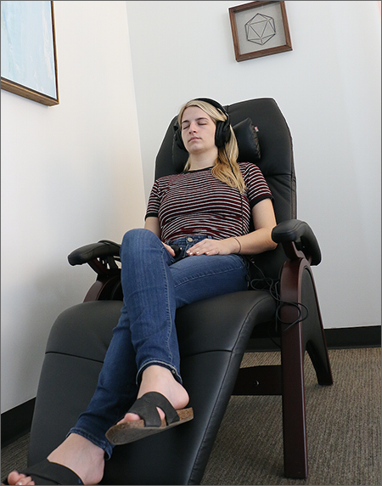
Self-Care
Breathing Exercises
Muscle Relaxation
Meditation
Relaxation Imagery / Relaxation Sounds
Guided Imagery
Health & Well Being
Sleep Issues
Food & Eating Issues
Consulting
Medication
Mindbody Labs
Notes:
Image: mindbody labs site: https://cmhc.utexas.edu/images/mbl_three.jpg

Slide 25

Self-Care
Consulting
No appointment necessary
Medication
Get More Info
Notes:
image: mindbody labs: https://cmhc.utexas.edu/images/mbl_two.jpg

Slide 26

Self-Care
To manage and reduce stress,
Learn to Think Small!
Consulting
Get More Info
Medication
Stress Recess
Notes:
Image: mindbody labs: https://www.cmhc.utexas.edu/stressrecess/images/thinksmall100.jpg

Slide 27



Self-Care
Walk-in Service
Consulting
Medication
Individual Counseling
Group Counseling
Notes:
Images
Walk-in Service(Shutter Stock): https://www.shutterstock.com/ko/image-vector/business-peoples-isolated-on-gray-background-169347611?src=MSmG7TGfNFmwmSS3XgpZeg-1-25
Individual Counseling(Shutter Stock):
https://www.shutterstock.com/ko/image-photo/young-women-visit-her-psychotherapist-274805978?src=NJnxPsyA1ZiYz95Xb2X5Tg-1-34
Group Counseling (Shutter Stock):
https://www.shutterstock.com/ko/image-photo/people-sitting-circle-counseling-525198115?src=8rbLOoZnRE4Ob29f0RY7LA-1-65

Slide 28


Self-Care
Consulting
Medication
Medication Evaluations
Crisis line 24/7/365 at (512)471-CALL
Notes:
Images
Medication Evaluation
:https://www.shutterstock.com/ko/image-photo/female-doctor-comforting-depressed-patient-sitting-299690342?src=W7uYVjMvArE_Z6mxqSj3Lg-1-45
Crisis line
:https://www.shutterstock.com/ko/image-photo/emergency-call-urgent-accidental-hotline-paramedic-563794051?src=O78qux9MXQolMIpHVimlHA-1-17

Slide 29

Consulting Service for Staff and Faculty
Personal Counseling
Workplace Consultations
Managing Classroom Behavior
Communication
Safety concerns
Manager concerns
Managing Changes
Training- sites.utexas.edu/eap
Work/Life Balance – LifeCare
Stress Reduction and Biofeedback Center (SRBC) –sites.utexas.edu/srbc
Notes:
-original image

Slide 30

Tips for following up someone who faces distress & disruptive behavior
Be direct
Encourage
Provide Information
Clarify Expectations
Suggest, don’t insist
Notes:
File image(iStock)
http://www.istockphoto.com/photo/successfull-person-gm656462712-119526589
Be direct in letting the person know that you believe it’s important for them to get professional help in this situation. If you’re concerned about the stud, let them know this (e.g., “I’ve noticed you’ve been looking tired & stressed. Are you going through a rough time?”).
Point out that seeking professional help for problems is an indication of good judgment & a good use of resources (e.g., “If you had a broken arm, you’d go to the doctor rather than trying to set it yourself”).
Educating studs abt the counseling process can address their misgivings & can reduce the barriers to their getting the help they need. Inform them that counseling is confidential & is available at a low cost at CMHC (most services are free or have a $5 charge).
Make sure the student has contact name, number, & location of the referral. Prepare the student for what they might expect if they follow your suggestion – tell them what you know about the referral person or service. If the student is receptive, suggest they make an appointment.
Except in emergencies, the option must be left open for the student to accept or refuse assistance – don’t force the issue or try to trick the student into going.
Keep in mind that cultural factors may affect a stud’s openness to speaking w/a counselor (eg, may mistrust counselors due to discrimination, cultural beliefs abt mental health & counseling, cultural values around shame & pride & the importance of keeping fam probs w/in the fam).
Offer to meet with the student again - this may help solidify their plan to obtain appropriate help, & also demonstrates your commitment to helping them with this process. However, it’s important to be sensitive to a student’s desire for privacy.

Slide 31
Question:
Which counseling method can you take if you meet distress or/and disruptive behavior in class?
Walk-in Service
Individual Counseling
Group Counseling
Medication Evaluation
All of these are correct answers!
Look for experts’ help if you feel hard to handle it.

Slide 32
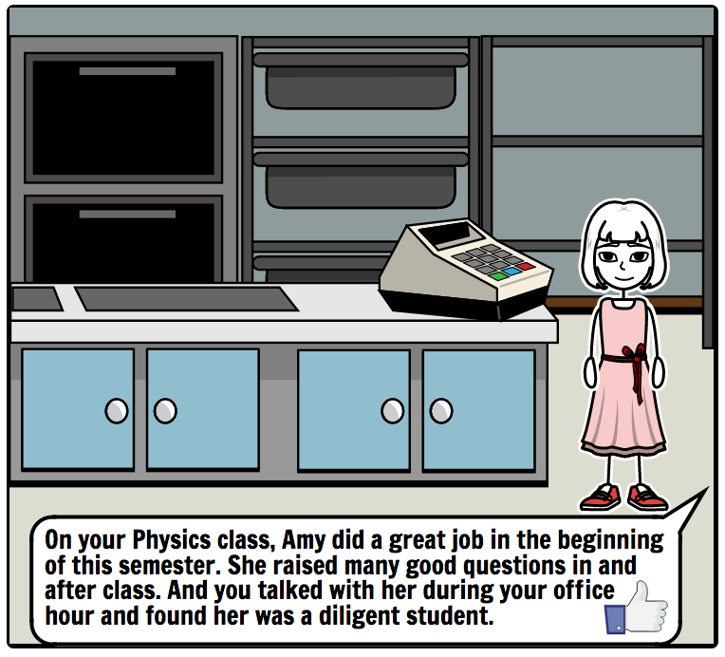
Scenario 1 : Decline in academic performance
Since last week, she hasn’t submitted two assignments. A classmate complained Amy didn’t show up in group meeting.
Let her go. It’s none of my business. What I need to do is give her a fair grade in the end of the semester according to her performance.
Find a chance after class asking whether she met problems in studying.
Ask Amy’s friend to know about her.

Slide 33
Scenario 1 : Decline in academic performance
Feedback
You can definitely do that. You do nothing wrong. It’s just not the best choice.
Excellent! Showing her that you care about her, and let her know you are there.
Not bad. Knowing from others is a way. If Amy’s friend doesn’t even know, maybe you still have to turn to Amy finally.

Slide 34
Scenario 2 : Unusual appearance
Every student may have bad days, it's no big deal. Just ignore Jack and keep on teaching the class.
Ask Jack directly and promptly in front of the whole class.
Have a private talk with Jack after class, and show you care about him.
Blame Jack for disturbing the class and ask him to concentrate on class.

Slide 35
Scenario 2 : Unusual appearance
Feedback
It’s not a good option. Maybe Jack is having a hard time in his life and he needs others’ care and support.
It’s not a good option. It’s impolite to ask Jack about his personal things, especially in front of a lot of students.
It’s a good option! Talking with Jack after class gives him a comfortable atmosphere to talk. Showing care gives a feeling of trust.
It’s not a good option. Blaming someone in public is a very rude behavior and it might have some negative impact on Jack in terms of his mental and/or physical health.

Slide 36
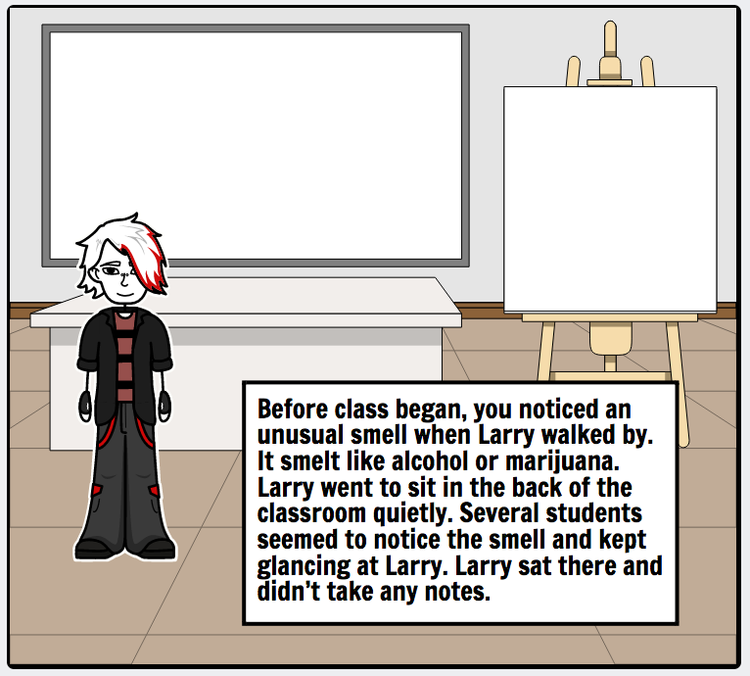
Scenario 3 : What’s That Smell?
Approach the chemically-altered student and saying, “You seem to me to be *very tired*. I think you should go back to your dorm and get the rest you so obviously need.”
I would tell him/her that if such behavior continues, I would ultimately have to report him/her to the person charged with handling student disciplinary concerns.
Let the student know that I am there for him/her.
simply stop lecturing till the disruption stops. Peer pressure will bring them around.

Slide 37
Scenario 3 : What’s That Smell?
Feedback
It’s a good choice. Showing students care without bothering him/her.
You are a strict teacher! You follow the school rules nicely!
That’s a sweet choice!
It’s a solution. Peer pressure will work. Don’t use this method very often, or it will lose effect.

Slide 38
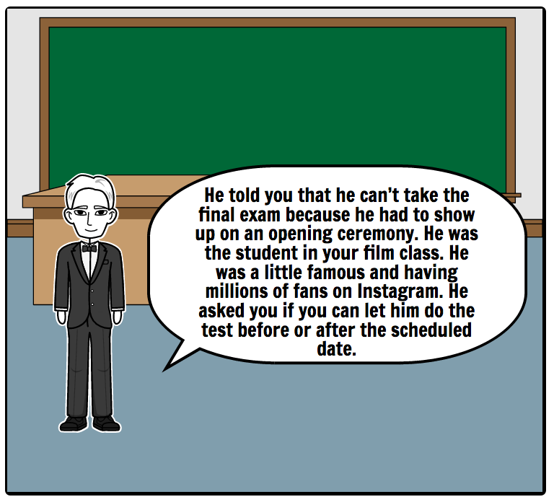
Scenario 4 : The Entitled (Students of the rich and famous)
It shows the student’s immaturity or misguided sense of power and celebrity. I look down on those kind of students.
Turn to faculty for help who may not be as experienced with this kind of disruption.
Refer the student to the university policy -- which is my policy.

Slide 39
Scenario 4 : The Entitled (Students of the rich and famous)
Feedback
Yes, the student misunderstood his/her power. But you should treat students evenly and respectively.
That’s a lovely choice! As a new TA/AI, if you don’t know how to handle these situations, learn from others who are experienced.
Following rules is a smart choice! It’s better to pay attention to your tongue in case the student brings you trouble.

Slide 40
3. Title IX

Slide 41
A report was released in March, 2017 showing the prevalence of sexual assault and misconduct at the University of Texas at Austin. The data is drawn from the Cultivating Learning and Safe Environments (CLASE) survey that the University of Texas System conducted at 13 UT institutions across the state last year.
CLASE found that 15% of undergraduate women at UT Austin reported that they had been raped, either through force, threat of force, incapacitation or other forms of coercion such as lies and verbal pressure.
Furthermore, 28% of undergraduate women at UT Austin said they were the victims of unwanted sexual touching, and 12% experienced attempted rape. 13% of graduate and professional school women said they experienced crude sexual harassment perpetrated by a staff or faculty member, with 30 % experiencing sexist gender harassment and 5% unwanted sexual attention harassment.

Slide 42
Why are you taking this Title IX training?
Education Amendments of 1972
“No person in the United States shall, on the basis of sex, be excluded from participation in, be denied the benefits of, or be subjected to discrimination under any education program or activity receiving Federal financial assistance.”
More importantly, we want to eliminate sexual harassment and sexual misconduct from our University!
Notes:
-original image
<Check Hyperlink
Women, men and GLBT are protected from sex discrimination (including sexual harassment)
The United States Department of Education (Office for Civil Rights) enforces Title IX
All public and private universities receiving any federal financial assistance must comply with Title IX

Slide 43
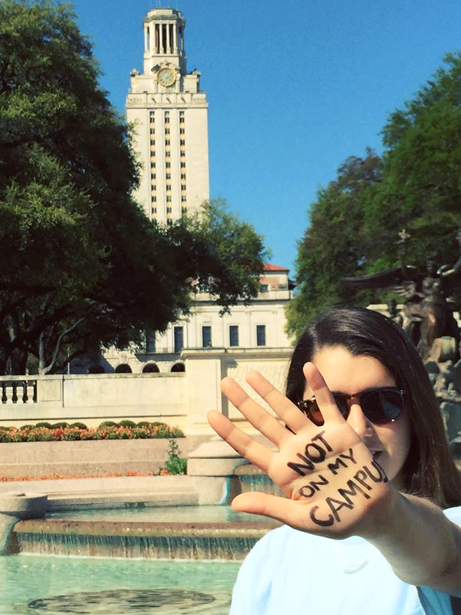
University Commitment
UT Austin is committed to maintaining a working and learning environment that is free from discriminatory conduct based on gender. As required by Title IX, the University does not discriminate on the basis of sex/gender in its programs and activities.
UT Austin encourages all members of the university community who think that he or she has been subjected to sex/gender discrimination, sexual harassment (including sexual violence) or sexual misconduct by another student, member of the faculty or staff, campus visitor or contractor, to report to the University.

Slide 44
Definitions
Sexual Misconduct: Behavior or conduct of a sexual nature that is unprofessional and/or inappropriate for the workplace.
Sexual Harassment: Unwelcome sexual advances, requests for sexual favors, and other verbal/physical conduct of a sexual nature. A form of discrimination.
Sexual Violence: The worst form of harassment and includes rape, sexual assault, sexual battery, and sexual coercion.
For more information, see policy Handbook of Operating Procedures 3-3031

Slide 45
Definitions
These definitions can also be thought of in relation to one another. Sexual misconduct is the broadest category, with sexual violence being the narrowest.
Sexual misconduct
Sexual discrimination
Sexual harassment
Sexual violence

Slide 46

Two Types of Sexual Harassment
Quid Pro Quo
Employment or education decisions based on a request for sexual favors.
-Example: “If you go out with me, I’ll give you a promotion”
A power difference between the harasser and the victim
-Example: Professor and a graduate assistant

Slide 47

Two Types of Sexual Harassment
Hostile Environment
Unwelcome conduct that unreasonably interferes with an employees’ ability to work or a student’s ability to learn OR creates an intimidating, hostile, or offensive work or learning environment
Consider circumstances including: context of the conduct, frequency, and severity

Slide 48

Interplay between Title IX & Clery Act
The Clery Act is a federal law that requires institutions to disclose information about crime reported on and around their campuses
Violence Against Women Reauthorization Act of 2013 (VAWA) includes:
Domestic Violence
Dating Violence
Stalking

Slide 49
Who is responsible Employee? (HOP 3-3031 and GIC Appendix D)
Administrators
Academic advisors
Coaches, and other athletic staff who interact directly with students
Residence life directors
Resident assistants
All supervisory staff
Faculty members, including professors, adjuncts, lecturers, associate/assistant instructors (AIs)
Teaching assistants (TAs)
Graduate research assistants
TA/AI Must report Title IX related incidents
(past or present) as a University employee!

Slide 50
As a Responsible Employee, to Whom Do I Report?
University Title IX Coordinator (LaToya Smith)
512- 232- 3992 1616 Guadalupe, UTA Suite 2.507 titleix@austin.utexas.edu
Deputy Title IX Coordinator (Linda Millstone)
512- 471- 2437 1616 Guadalupe, UTA Suite 2.206 titleix@austin.utexas.edu
Deputy Title IX Coordinator for Students (Doug Garrard)
512 471- 5017 Student Emergency Services, 100 W. Dean Keaton, SSB 4.104
studentemergency@austin.utexas.edu
Deputy Title IX Coordinator for Faculty/Staff
512- 471- 1849
Office for Inclusion and Equity, 101 East 27th, NOA 4.302 equity@utexas.edu

Slide 51
Who handles the report?
Office for Inclusion and Equity
Office of the Dean of Students
Faculty & Staff
Student Employee
(TA, GRA)
Student
Notes:
Office for Inclusion and Equity handles complaints when the Respondent is a Faculty or Staff member, a contractor, etc.
Office of the Dean of Students handles complaints when the Respondent is a Student
When the Respondent is a Student Employee (TA, GRA, etc.), these two entities collaborate on the investigation

Slide 52
Who handles the report?
Office for Inclusion and Equity handles complaints when the Respondent is a Faculty or Staff member, a contractor, etc.
Office of the Dean of Students handles complaints when the Respondent is a Student
When the Respondent is a Student Employee (TA, GRA, etc.), these two entities collaborate on the investigation

Slide 53
Who handles the report?
Some important terms:
Complaint:
A signed document or other report, including verbal reports (if appropriately acknowledged), alleging a violation of this policy.
Complainant:
A person who submits a complaint alleging a violation of this policy.
Respondent:
The person designated to respond to a complaint. Generally, the respondent is the person alleged to be responsible for the prohibited conduct alleged in a complaint.

Slide 54
Timeframe for Title IX cases
OCR (Office of Civil Rights) guidelines include a 60 day timeframe to investigate, remedy, and resolve any allegation.
If the complainant does not report the Title IX incident in a timely manner, accommodations and remedies provided by the university may be diminished.
DAY
60
Notes:
File image(iStock)
Upper: http://www.istockphoto.com/photo/privacy-please-gm180707149-24006545

Slide 55

Privacy vs. Confidentiality
As a RESPONSIBLE EMPLOYEE you cannot maintain confidentiality but you can protect privacy.
This means that you must report the incident once the student talks to you about the incident, but you can keep it private by not telling to the class or your colleagues. You can also inform the student that you are not a confidential place to report and refer them to reach out for confidential reporting options before they speak out.
Notes:
File image(iStock)
Upper: http://www.istockphoto.com/photo/privacy-please-gm180707149-24006545

Slide 56
Here are the confidential reporting options for students
Confidential Reporting Options
Counseling Mental Health Center (CMHC)
512-471-3515
CMHC Crisis Line (24/7)
512-471-2255
University Health Services (UHS)
512-471-4955
Employee Assistance Program (EAP)
512-471-3366

Slide 57
What are Retaliation Actions?
Any action that adversely affects the academic, employment, or other institutional status of a student or employee of the University, visitor, applicant for admission to or employment with the University, because an individual has, in good faith, brought a complaint under this policy, opposed an unlawful practice, participated in an investigation, or requested accommodations.
Notes:
Audio file for explanation
: Any action that adversely affects the academic, employment, or other institutional status of a student or employee of the University, visitor, applicant for admission to or employment with the University, because an individual has, in good faith, brought a complaint under this policy, opposed an unlawful practice, participated in an investigation, or requested accommodations.
-Add interactive images
: leaners should click images, and then show up explanation.

Slide 58
What are Retaliation Actions?
Threats, intimidation
Disciplinary actions
Failure to accommodate needs
Any retaliation action is prohibited!
Forcing or pressuring complainant to take time off from school/work
Removing complainant from teams, clubs
Notes:
Audio file for explanation
: Any action that adversely affects the academic, employment, or other institutional status of a student or employee of the University, visitor, applicant for admission to or employment with the University, because an individual has, in good faith, brought a complaint under this policy, opposed an unlawful practice, participated in an investigation, or requested accommodations.
-Add interactive images
: leaners should click images, and then show up explanation.

Slide 59
Reporting Process
1. Listen and express compassion and offer assistance
2. Inform individual of your need to report the incident
3. Contact Title IX Coordinator with name of complainant and name of respondent if known
4. Appropriate Deputy Title IX person will reach out to complainant
5. Respondent is also offered resources and options, as appropriate
After step 4, complainant does not have to respond if he/she does not wish to.

Slide 60
Think about “WHAT IF”
What if the student does not want the information reported, what do I do?
What if a student tells me about an assault that happened while in High School?
What happens if I do not report?

Slide 61
Answers to “WHAT IF”
Refer the student to reach out for confidential reporting options
Report the incident to Title IX coordinator. However, since the incident happened several years ago, accommodations and remedies provided by the university may be diminished.
Students or employees can bring lawsuits against university which can result in millions of dollars in judgments or settlements. This may also bring termination of all or part of the university’s federal funding.

Slide 62
Question:
Which of the following descriptions are examples of sexual misconduct and sexual harassment?
Asking a pregnant student to wait out the semester
Leering or staring intently
Inappropriate touching or impeding or blocking someone's movements
All of these are correct answers!
Look for experts’ help if you feel hard to handle it.

Slide 63
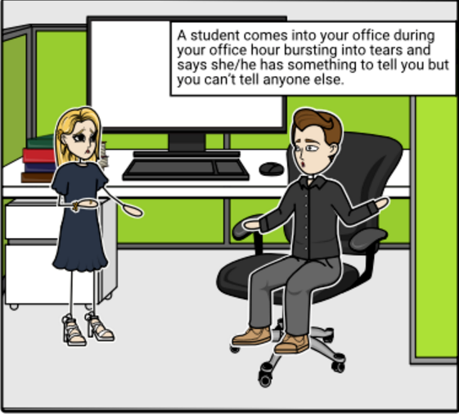
Scenario 1
Every student may have bad days, it's no big deal. I just need to show my concern and compassion for her/him.
I can’t report the incident even if it’s reportable on the student covered by Title IX, because I should keep my promise not to tell anyone else.
If the incident took place that is reportable on the student or is covered by Title IX, I must report it to the Title IX coordinators on campus within 24 hours.

Slide 64
Scenario 1
Feedback
It might be an appropriate way to handle this if the incident didn’t violate any law.
No, it’s your responsibility to report the incident if it’s reportable on the student covered by Title IX as a college employee. And you can’t ensure the confidentiality but you can protect privacy by confidential reporting like calling Counseling Mental Health Center (CMHC) and UHS.
That’s the right way to deal with Title IX cases. You know well your responsibility as a college employee.

Slide 65
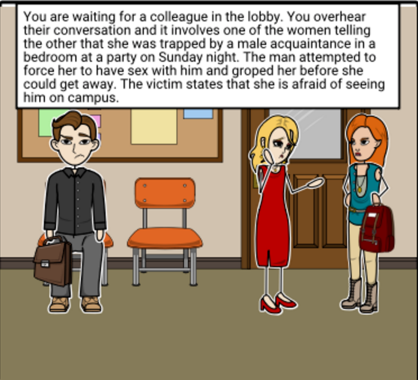
Scenario 2
Approach the girls and let them know you are concerned about what you heard and advise them to go to the Dean of Students’ Office.
Ask the victim if she’ll tell you more about what happened and again, encourage them to speak with the Dean of Students’ Office.
Get at least one name so you can report it to the Title IX coordinators and they can follow up with the student.
I just overheard about this and it’s the students’ privacy. It’s not polite to advise them and I can do nothing about this.

Slide 66
Scenario 2
Feedback
Any one or two of ABC: Yes, you can deal with it in this way. It’s important to get at least one of the names. But there might be other options depending on your level of comfort.
All of ABC: Yes, you are right! This scenario constitutes notice to the College of a sexual assault. As a college employee, you must report this. And you chose the three possible ways to handle this depending on your level of comfort.
Only D: Although you just overheard about it, you are still required to report this case to the Title IX coordinators.

Slide 67
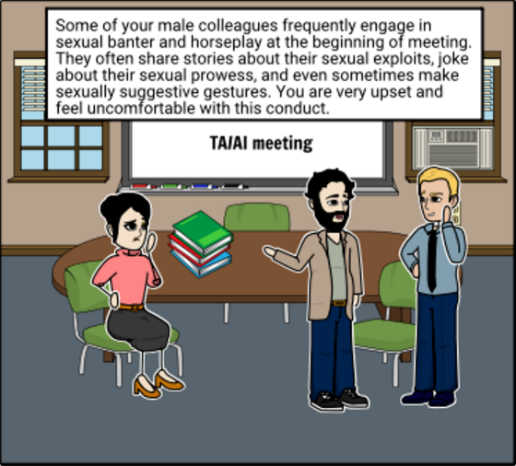
Scenario 3
Short answer questions
Is the behavior of Sally’s male colleagues unwelcome?
Is the conduct described above sexual harassment?

Slide 68
Scenario 3
Expected answers
1. Yes. Based on the information in the example, it appears the conduct is unwelcome.
2. Probably, yes. To constitute sexual harassment the conduct must not only be unwelcome, but it must also be severe and pervasive. The information contained in the example concerning the frequency and nature of the conduct suggests it is severe and pervasive.
Notes:
Note:
As long as the students can justify themselves is acceptable.

Slide 69
4. BE SAFE Campaign

Slide 70
^{More Police Around}
What if..?
^{More lights on the path}
We would not be in danger!
^{Safe Ride} ^{Program}
^{Trimmed} ^{Hedges}

Slide 71

Think of Safety as a thing that is provided to UT Austin students, faculty members, and staff members
Notes:
: http://www.istockphoto.com/photo/3d-people-gm603899728-103692775

Slide 72
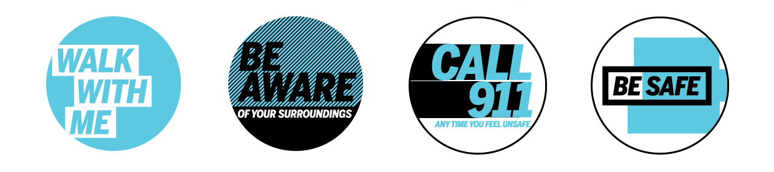
‘BE SAFE Campaign’ is an effort to shift the thinking toward the idea that when folks look out for each other, the entire community becomes safer by the University and UTPD.

Slide 73
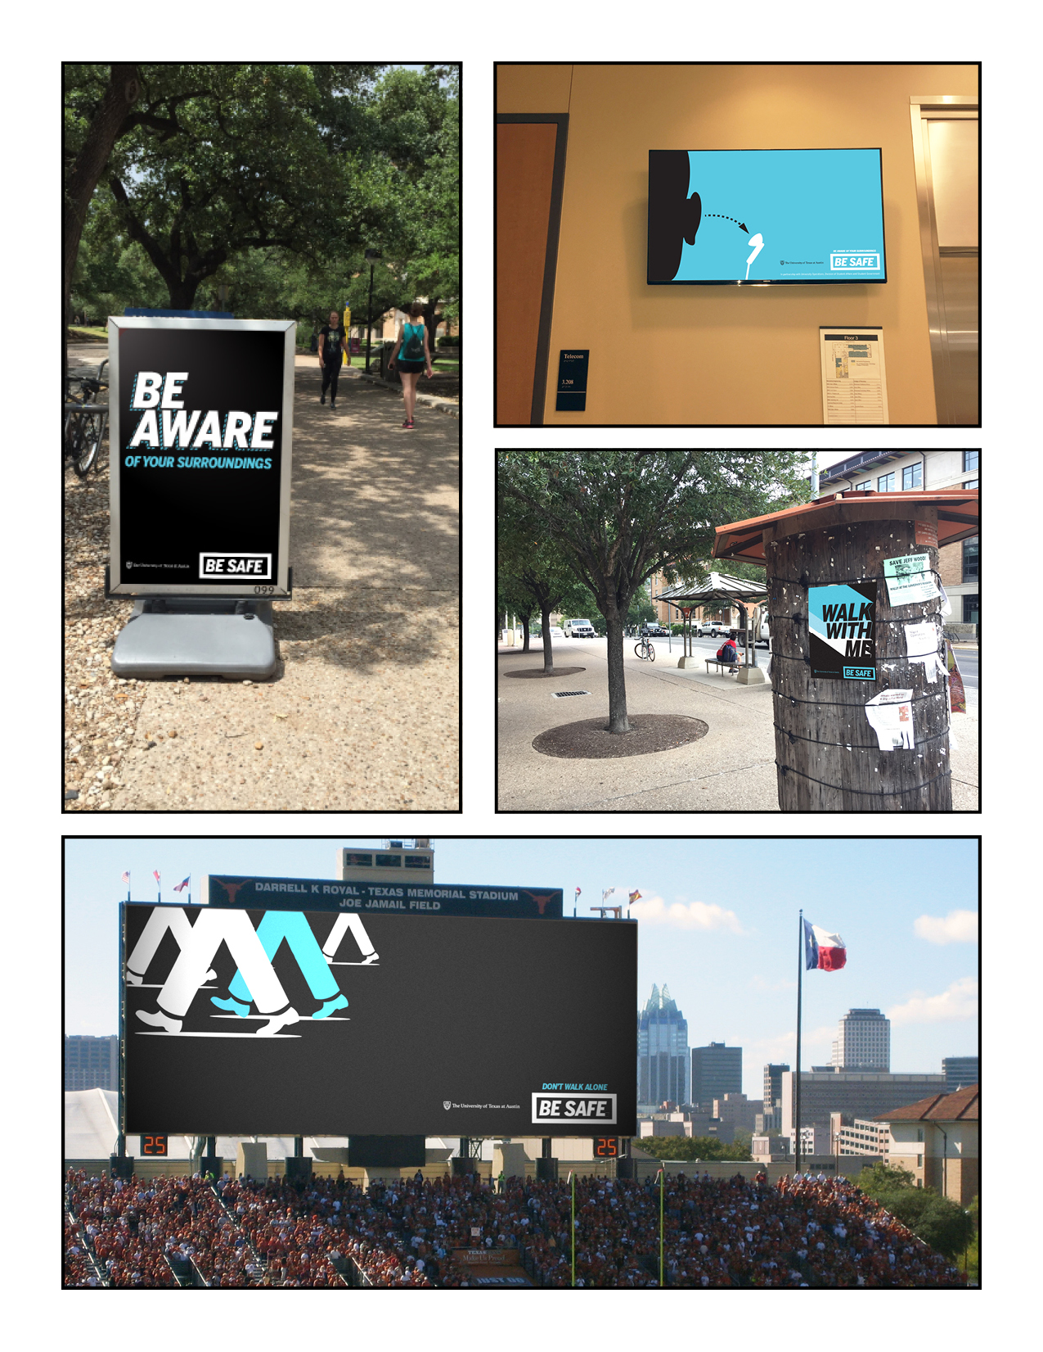
Look at these Creative Designs!

Slide 74
Use your creativity to help share the BE SAFE message!
You can get an opportunity to express yourself by creating an artistic representation of what the BE SAFE Campaign means to you.

Slide 75
Let’s BE SAFE Together!
Phase 1
Deliver the primary messages
Walk with me
Be Aware
Call 911
Each point gets its own poster/execution, simple and clear.
Introduce Be Safe logo, UTA logo, and color palette that will be consistent throughout campaign.
Phase 2
Phase 3
Phase 4

Slide 76



Let’s BE SAFE Together!
Phase 1
Phase 2
Phase 3
Phase 4

Slide 77
Let’s BE SAFE Together!
Phase 1
Each point gets its own mini-campaign.
• Graphic representations of each point.
• The point should be displayed above the Be Safe logo.
• Demonstrate consistency of Be Safe logo, UTA logo, and color palette.
Phase 2
Phase 3
Phase 4

Slide 78


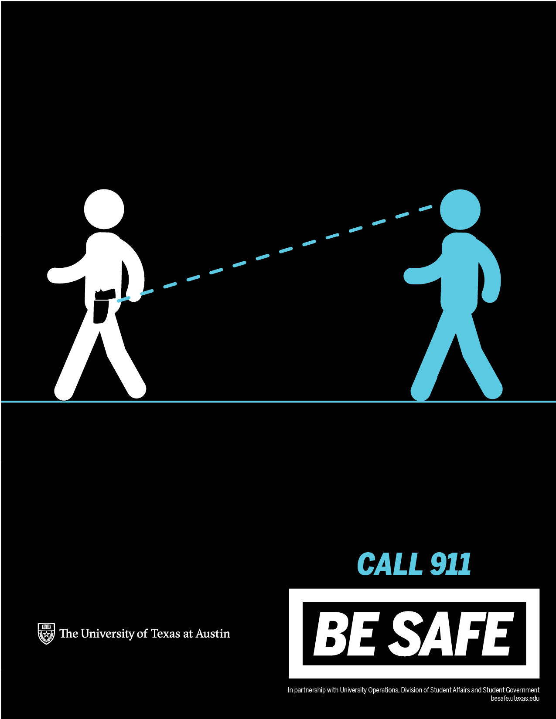
Let’s BE SAFE Together!
Phase 1
Phase 2
Phase 3
Phase 4

Slide 79
Let’s BE SAFE Together!
Phase 1
Each point continues its own mini-campaign.
• Verbal representations of each point to convey that safety is a simple casual conversation that can be had anytime which means remind folks that they have active participation in their own safety.
• The point should be displayed at the top of the signage.
Phase 2
Phase 3
Phase 4

Slide 80
Let’s BE SAFE Together!
Phase 1
• Introduce use of a hashtag, to be placed above the Be Safe logo.
• Possible hashtags: #SafetyConvo, #BeSafeConvo, #SafeConvo, #StartTheConversation, #StartTheConvo, #TalkAboutSafety
• Demonstrate consistency of Be Safe logo, UTA logo, and color palette.
Phase 2
Phase 3
Phase 4

Slide 81
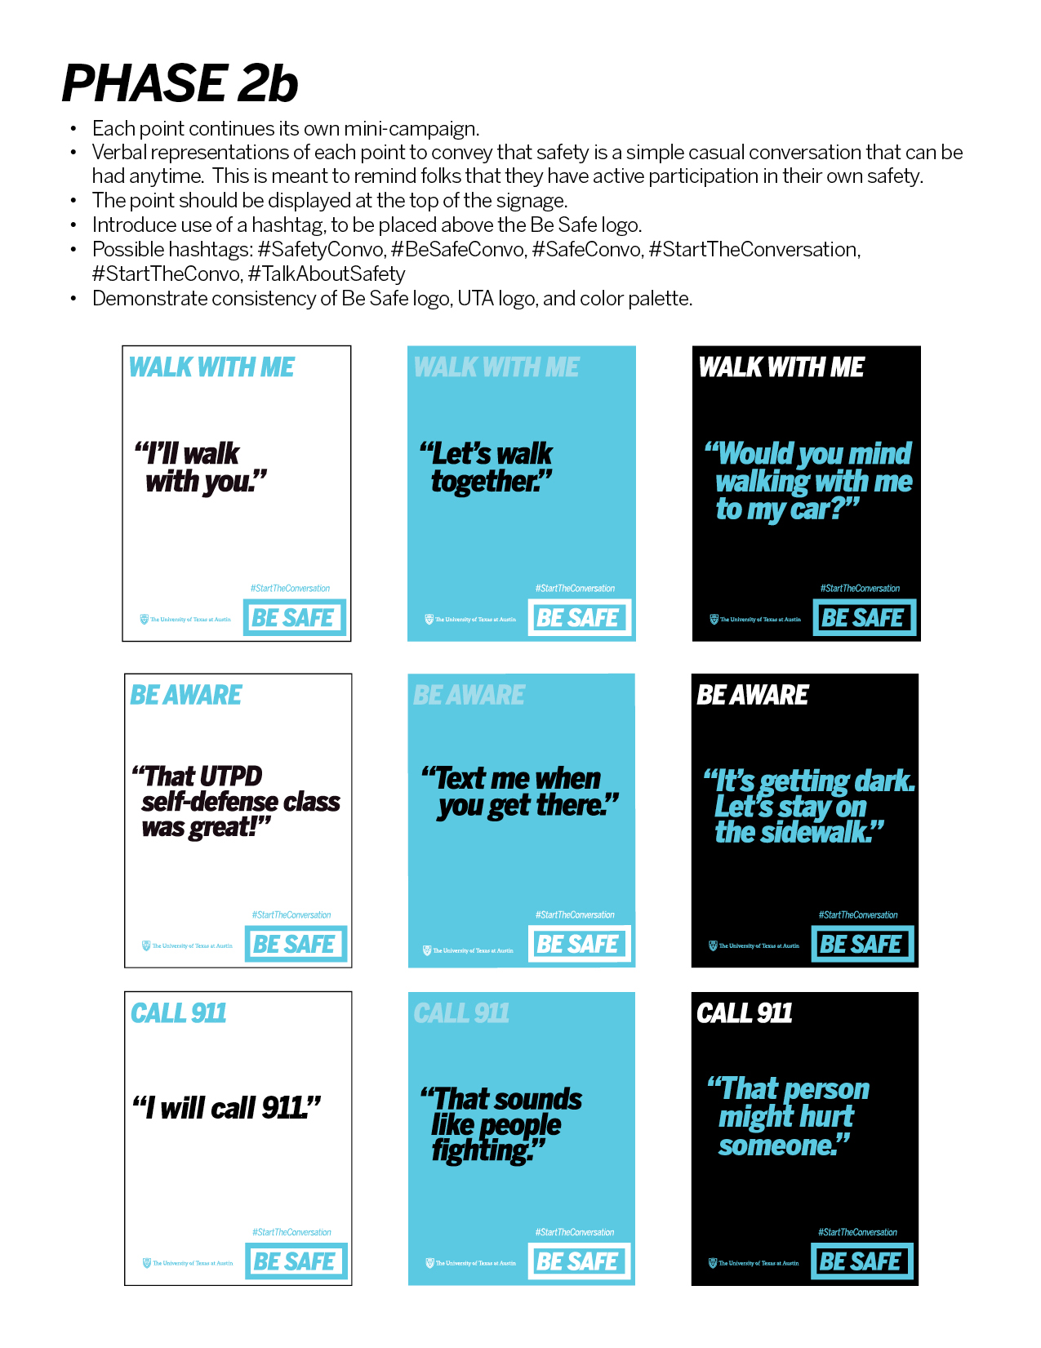
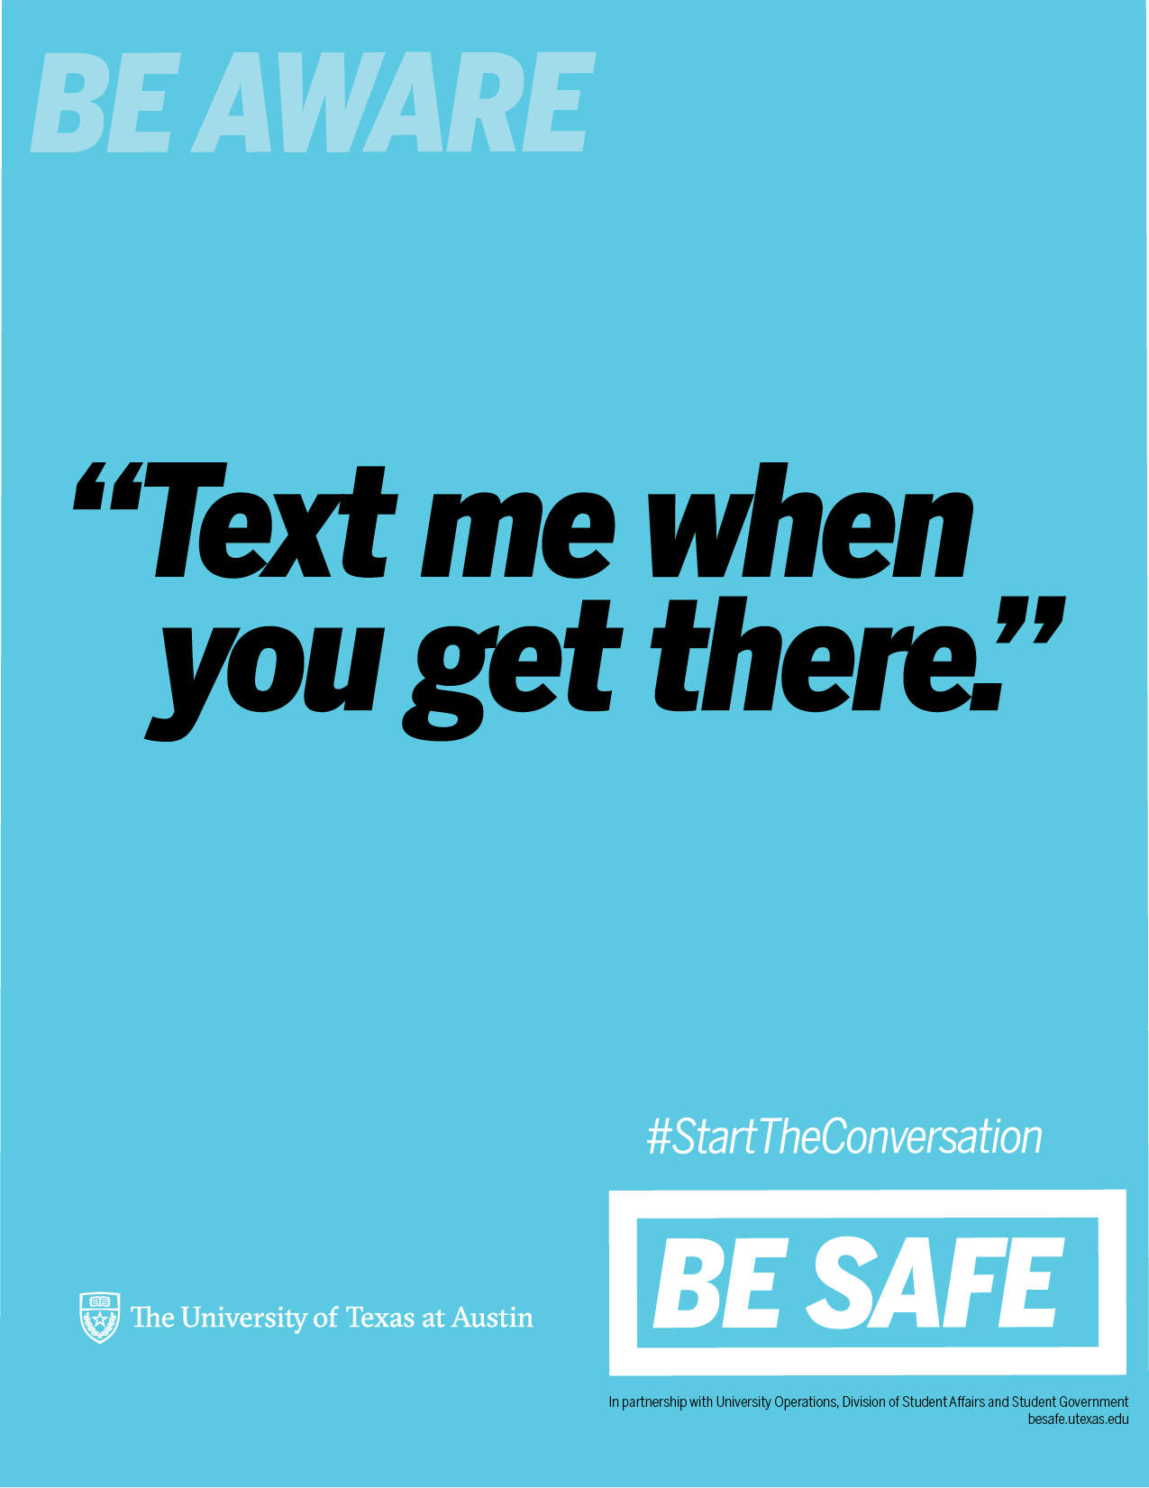
Let’s BE SAFE Together!
Phase 1
Phase 2
Phase 3
Phase 4

Slide 82
Let’s BE SAFE Together!
Phase 1
Student-executed work.
• Students would be allowed to create a representation of any point in any medium using any style.
• Must adhere to the color palette.
• The Be Safe Logo and UTA logo must be present. (We would add it.)
Phase 2
Phase 3
Phase 4

Slide 83
Let’s BE SAFE Together!
Phase 1
• The represented point (e.g. Don’t Walk Alone) must appear above the Be Safe logo, if not already present in the work.
• Demonstrate consistency of Be Safe logo, UTA logo, and color palette.
Phase 2
Phase 3
Phase 4

Slide 84
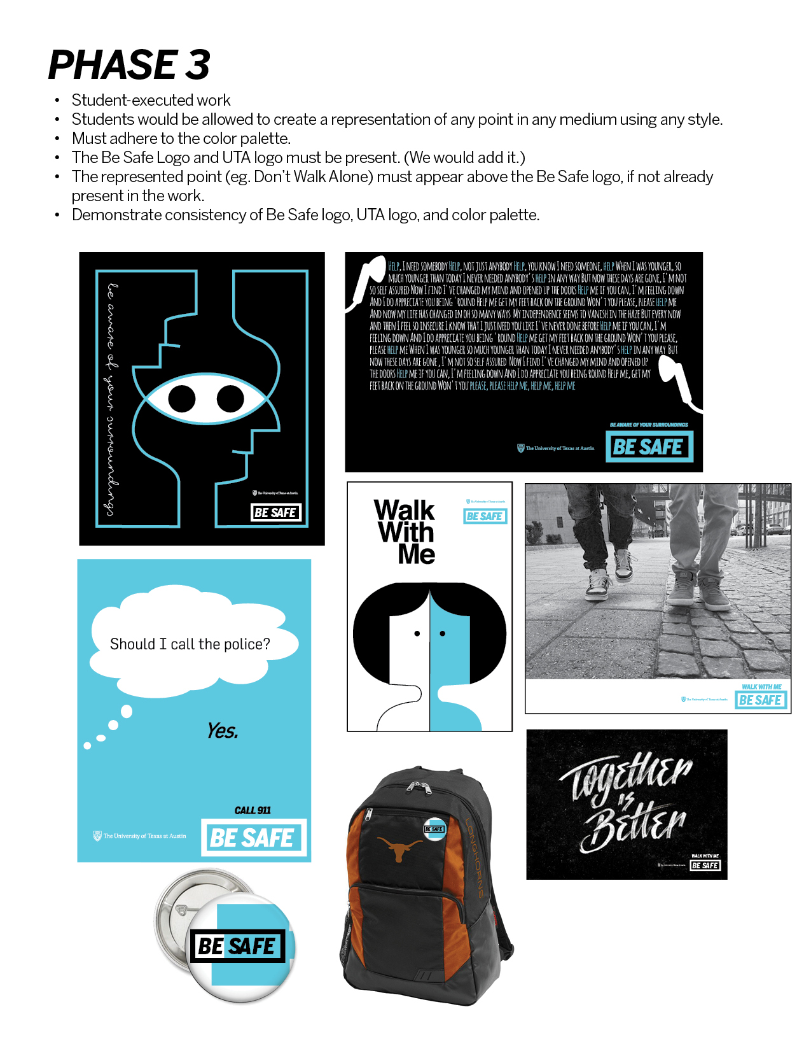
Let’s BE SAFE Together!
Phase 1
Phase 2
Phase 3
Phase 4

Slide 85
About the Campaign
Be as creative as you want to be. Executions could include, but are not limited to:
Social media posts and/or imagery
• Kiosk posters
• Art posters
• Short film/video
• GIF/animations
• Written pieces Short stories
Poems
Editorials
Song lyrics
Performance piece
Music
Dance
Fine art
Painting
Drawing
Sculpture
Pottery
Mural Photography

Slide 86

About the Campaign
To get further information about how to participate, participation requirement, design requirements, and detailed guideline, Click the right image!
Notes:
Istock
http://www.istockphoto.com/photo/help-support-advice-guidance-signpost-gm519749080-90696239

Slide 87
5. Campus violence & Campus carry

Slide 88

Jim Sporleder
The Center for Personal Protection and Safety
“The possibility of being involved in an Active Shooter incident on campus may be remote, but the consequences can be catastrophic. That’s why it makes good sense for you to spend some time thinking about what you would do if you found yourself in such a situation.”
Notes:
Image: http://cppsweb.com/wp-content/uploads/2015/03/Jim-Pic-199x300.jpg

Slide 89
Motivating beliefs on campus violence
Individual actors involved in active shooting incidents have had a variety of motivating beliefs.
Notes:
Image(shutter stock)
https://thumb7.shutterstock.com/display_pic_with_logo/168430/316813037/stock-photo-right-or-wrong-as-a-versus-choice-of-different-belief-316813037.jpg

Slide 90


Motivating beliefs on campus violence
Sometimes,
someone possessed a misguided sense that they were part of a global terror cause,
while in other instances they possessed grievances, real or perceived.
Notes:
Image(istock)
Upper: http://media.istockphoto.com/vectors/businessman-with-angel-and-devil-on-his-shoulders-vector-id165794335
Below: http://media.istockphoto.com/vectors/distraught-vector-id642689944

Slide 91



Motivating beliefs on campus violence
Clearly most cases
involving “active shooters”, involve some sort of mental imbalance or psychosis.
Notes:
Image(istock)
Left one: http://media.istockphoto.com/illustrations/person-having-a-panic-attack-amidst-a-faceless-crowd-illustration-id160550386
Middle one: http://media.istockphoto.com/vectors/brain-confusion-vector-id510463252
Right one: http://media.istockphoto.com/illustrations/psychiatry-word-cloud-concept-7-illustration-id663642950

Slide 92

Motivating beliefs on campus violence
In many instances,
Erratic or concerning behavior leading to an attack was known by others, (e.g. , family, friends or co-workers),
Yet remained unknown to responsible authorities.
Notes:
Image(istock)
http://media.istockphoto.com/vectors/big-hand-pointing-a-businessman-vector-id621727476
Upper: http://media.istockphoto.com/vectors/killer-2-vector-id515815816

Slide 93
Attention! Here are Tips for You
People do not just SNAP. They move down path toward “Just Snap”.
Action Points - Note it, talk to subject, REPORT it
Suicide Prevention - Among the most common distress call into UTPD
Whom to Report - Police, Dean of Students, RA, Professor, Student Counseling Center, Provost Office or Behavior Concern Advice Line!
Awareness plus Action -You can be the one that prevents catastrophe!
Behaviors of Concern - Intimidation, Harassment, Bullying, Making threats
1
2
3
4
5
6

Slide 94




Proactive partnership to provide the safest environment we can for all members of the university community.
Click images to get more information!

